Slide 1

BM Dataset for pseudotime

Slide 2
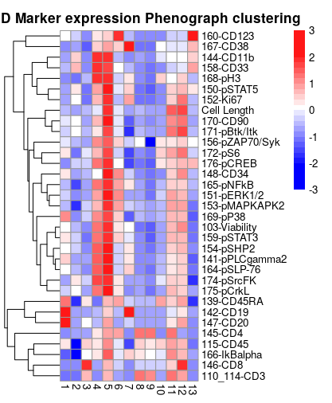
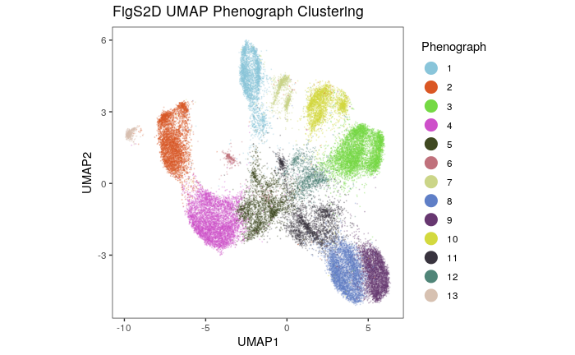

Slide 3
